Slide 1

Hybrid SharePoint Search
Everything YOU need to know
Max Melcher
Track: * | Level: 300

Slide 3
Agenda
What is Hybrid Search?
Hybrid: What? When? How?
Architectural Challenges
What are the benefits?
Summary / Q&A
Notes:
Go through the agenda of this talk
Hybrid Search
Heteronomous environments and how SharePoint tackles this
What options are available
What are the benefits
45 Minutes talk and ~15 Minutes Questions
2 live demos

Slide 4


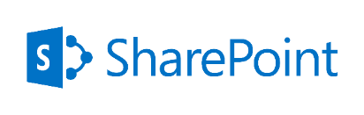
Maximilian Melcher
Max (MCSE, MCPD) is a Principal Consultant and Business Line Manager for SharePoint working at Alegri International Services in Munich, Germany. Max is a specialist in SharePoint technologies focused on search, web content management and collaboration. Max has led SharePoint implementations for Dax 30 companies since 2009.
Twitter: @maxmelcher
Blog: http://melcher.it
Email: Maximilian.Melcher@alegri.eu
www.alegri.eu

Slide 5
Hybrid Overview
What options are available today?

Slide 6
Hybrid Options
Outbound Hybrid
Inbound Hybrid
Cloud Hybrid Search
Fed
Query
Fed
Query
Fed
Query
Crawl
Notes:
Hybrid – 3 Options.
Definition of hybrid here is two plattforms communication to each other depending on the workload.
Outbound, Inbound, Cloud Hybrid are the three available options of today.
All of them come with different feature sets, most of them can be combined.
In the next couple of slides I am going to tell you how the mechanics work so that you understand the architecture

Slide 7
One-way outbound
Intranet
Office 365
On-Prem Network
Internet
Office 365 tenant
SharePoint Server 2013/2016 Farm
SharePoint Online
SharePoint
Outbound
Inbound
Online search results only
Site collection
Web Application
Hybrid search results
Online cannot query SharePoint Server
SharePoint Server can query SharePoint Online
On-premises SharePoint Server 2013 Enterprise Search portal: Local and remote search results are available
SharePoint Online search portal: Local search results are available

Slide 8

Notes:
Switch to demo environment to show Outbound Search
Search for „SharePoint online“
Result will be shown in a „result block“ – user experience is not that good.

Slide 9

Query Flow – On Premise Search Center
SharePoint
Online
User Profile Service App
Index Component
Query Processing Component
Index Component
SharePoint
On Premises
?
?
Index Component
On Premises
Search Center
Query Processing Component
Authenticated User
Index Component
Notes:
http://blogs.msdn.com/b/spses/archive/2015/05/20/the-all-new-cloud-search-service-application-coming-to-sharepoint-2013-and-sharepoint-2016.aspx

Slide 10
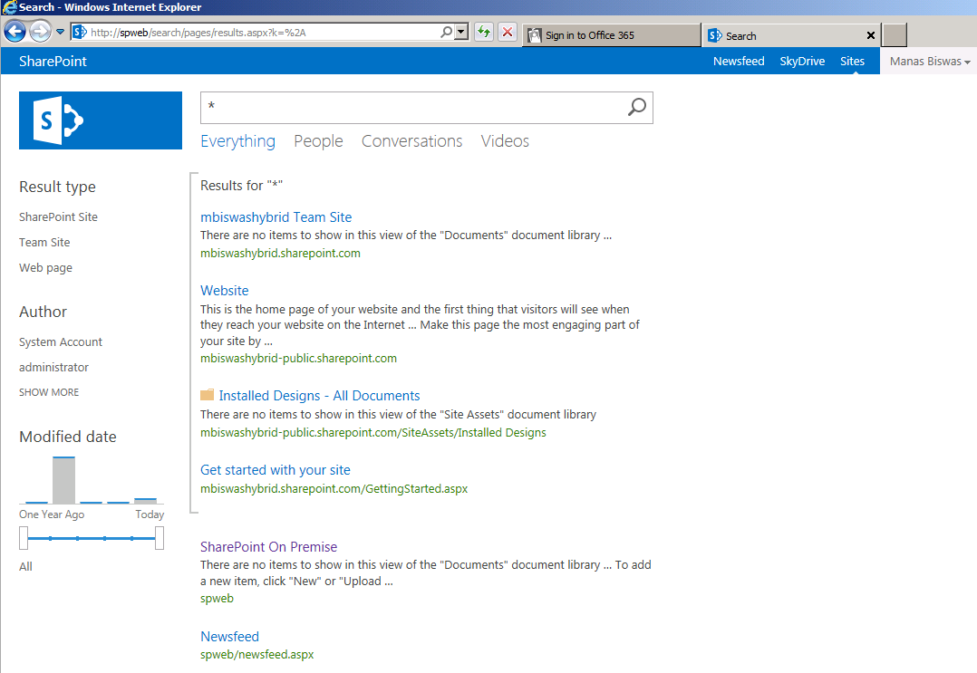
User Experience
Two disjunct result sets, ranking, sort order, etc
cloud
results
On-premises

Slide 11
One-way inbound
Intranet
Office 365
On-Prem network
Internet
Perimeter Network
Office 365 tenant
SharePoint Server 2013/2016 Farm
SharePoint Online
SharePoint
Outbound
Online search results only
Site collection
Web Application
Hybrid search results
Inbound
Reverse Proxy
SharePoint Online can query SharePoint Server
SharePoint Server cannot query SharePoint
On-premises SharePoint Server 2013 Enterprise Search portal: Local search results are available
SharePoint Online search portal: Local and remote search results are available

Slide 12
Two-way (bidirectional) topology
Intranet
Office 365
On-Prem network
Internet
Perimeter Network
Office 365 tenant
SharePoint Server 2013 Farm
SharePoint Online
SharePoint
Outbound
Online search results only
Site collection
Reverse Proxy
Web Application
Hybrid search results
Inbound
SharePoint Online can query SharePoint Server
SharePoint Server can query SharePoint Online
On-premises SharePoint Server 2013 Enterprise Search portal and SharePoint Online search portal: Local and remote search results are available

Slide 13
Hybrid Cloud Search Service Application
A new and simple alternative is available

Slide 14

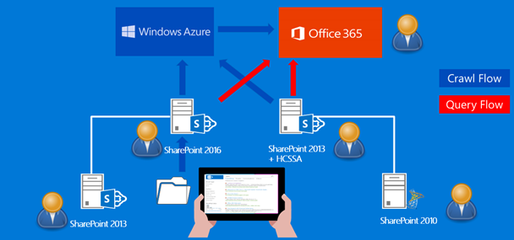
What is the Office 365 Hybrid Search?
Combination of on-premises and SharePoint Online
Search Index maintained in the cloud by Microsoft
Use existing environment (infrastructure, content)

Slide 15
Prerequisites for Cloud Search Service Application
Hybrid Search with Office 365
Office 365 subscription with SharePoint User CALs
Azure Directory Synchronization
Search Previews
Reverse proxy back to
on-premises OWA server
Infrastructure
Supported content sources
SharePoint Server 2007, 2010 or 2013
Fileshares, BCS connectors
SharePoint Server with
Cloud Search service application
2013 or 2016
Notes:
Prerequisites
Starting from bottom up, you need a crawler to index everything on premise and upload the data to the cloud (secure connection).
Supported data sources are SP, FilesShares, and LOB sources (think about SAP Master Data here)

Slide 16
Notes:
Switch to Cloud Result source

Slide 17
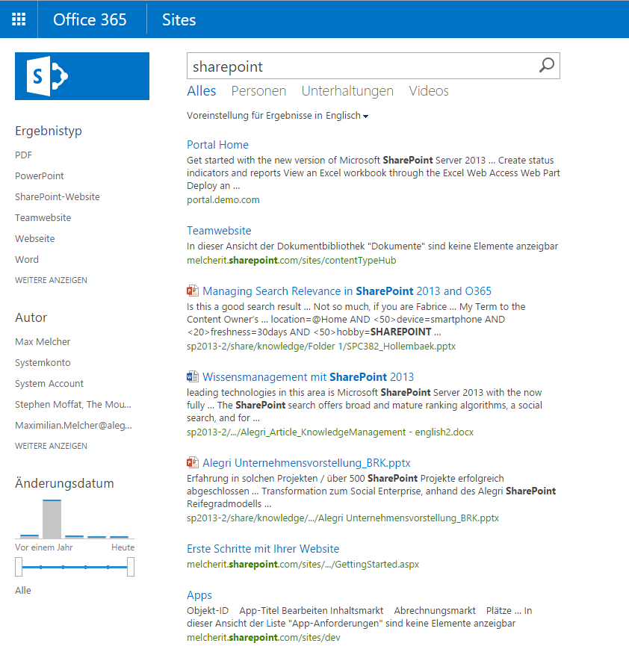
User Experience #2
SharePoint, On-premises
SharePoint Online
One
Index, ranking, sort order,
refiner,
etc
Fileshare, on-premises
SharePoint Online

Slide 18

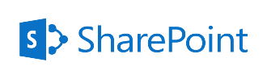

Hybrid Cloud Search: Crawl
SharePoint
Online
Index Component
Index Component
SharePoint
On Premises
SharePoint Content Sources
Content Processing Component
Notes:
Szenario: Offshore SharePoint Farm
Crawl Zeiten

Slide 19

Hybrid Cloud Search: Query
SharePoint
Online
On Premises
Search Center
User Profile Service App
?
?
Index Component
Authenticated
User
Query Processing Component
Index Component
SharePoint
On Premises
SharePoint Content Sources

Slide 20
Hybrid Cloud Search Service Application – Setup

Slide 21
Setup
Prerequisites
Setup AD Sync
Create Hybrid Cloud Search Service Application
$searchApp = New-SPEnterpriseSearchServiceApplication -Name $SearchServiceAppName –ApplicationPool $appPool -DatabaseServer $DatabaseServerName -CloudIndex $true
$searchApp.SetProperty("IsHybrid",1)
Microsoft online sign in assistant - http://www.microsoft.com/en-us/download/details.aspx?id=39267
Microsoft Azure AD PowerShell - http://go.microsoft.com/fwlink/p/?linkid=236297
Notes:
Briefly explain the prerequisites – time will be too short for this.

Slide 22
Setup #2
Run Onboarding Script:
Get-HybridSSA
Prepare-Environment
Connect-SPFarmToAAD
Add-ServicePrincipal
PreparePushTenant
Create content sources and crawl

Slide 23


Pros and Cons
Outbound Hybrid
Inbound Hybrid
Cloud Hybrid Search
Visualization
Two result sets
Query Latency
Easy to setup
onPrem users can see both worlds
Very difficult to setup (certificate, firewalls, etc.)
Visualization
Two result sets
Query Latency
Online users can see both worlds
Complex to setup
Two (or more) environments
Additional licenses for SharePoint Online
Technical Dept
Query Latency
Storage Pricing
Reduced indexing features
Microsoft maintains, backups scales the index
Utilize new features
Reduced footprint on-premises
Geo aware, better global performance

Slide 24

Questions?

Slide 25
Homework!
The all new Cloud Search service application coming to SharePoint 2013 and SharePoint 2016
Cloud Hybrid Search Service Application & Onboard Script
Why Hybrid Cloud is a cold hot potatoe?
SharePoint Escaltion Team Service Blog
https://melcher.it/category/search/ <= shameless self-promotion!

Slide 26
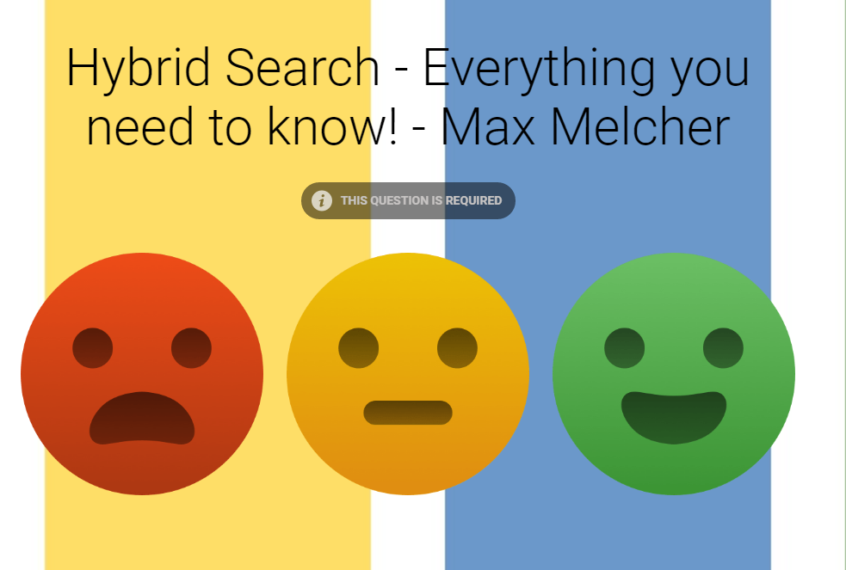
https://melcher.it/s/8S

Slide 27
